Slide 1

Retaining Telecom Customers
Troy Mayrand & Zachary Safir

Slide 2
Questions Asked
Given the data:
Can we find the most “at risk” customers that we need to focus on?
If there is a key “at risk” group, what defines this group?
Can we model it?
How can we hold on to these customers?

Slide 3
The Data
customerID gender SeniorCitizen Partner Dependents tenure PhoneService
0002-ORFBO: 1 Female:3488 0:5890 No :3641 No :4933 Min. : 0.00 No : 682
0003-MKNFE: 1 Male :3555 1:1142 Yes:3402 Yes:2110 1st Qu.: 9.00 Yes:6361
0004-TLHLJ: 1 Median :29.00
0011-IGKFF: 1 Mean :32.37
0013-EXCHZ: 1 3rd Qu.:55.00
0013-MHZWF: 1 Max. :72.00
(Other) :7037
MultipleLines InternetService OnlineSecurity OnlineBackup _
No :3390 DSL :2421 No :3498 No :3088
No phone service: 682 Fiber optic:3096 No internet service:1526 No internet service:1526
Yes :2971 No :1526 Yes :2019 Yes :2429
DeviceProtection TechSupport StreamingTV StreamingMovies _
No :3095 No :3473 No :2810 No :2785
No internet service:1526 No internet service:1526 No internet service:1526 No internet service:1526
Yes :2422 Yes :2044 Yes :2707 Yes :2732
Contract PaperlessBilling PaymentMethod MonthlyCharges TotalCharges _
Month-to-month:3875 No :2872 Bank transfer (automatic):1544 Min. : 18.25 Min. : 18.8
One year :1473 Yes:4171 Credit card (automatic) :1522 1st Qu.: 35.50 1st Qu.: 401.4
Two year :1695 Electronic check :2365 Median : 70.35 Median :1397.5
Mailed check :1612 Mean : 64.76 Mean :2283.3
3rd Qu.: 89.85 3rd Qu.:3794.7
Max. :118.75 Max. :8684.8
NA's :11
Churn _
No :5174
Yes:1869
7043 Customers
21 Customer Attributes
18 Categorical
3 Numerical
11 Missing values
Churn is turnover

Slide 4
Data Preprocessing I
Those 11 missing values?
Only occur in totalCharges
na.omit()
Manually convert SeniorCitizen to a factor because it was numeric by default.

Slide 5
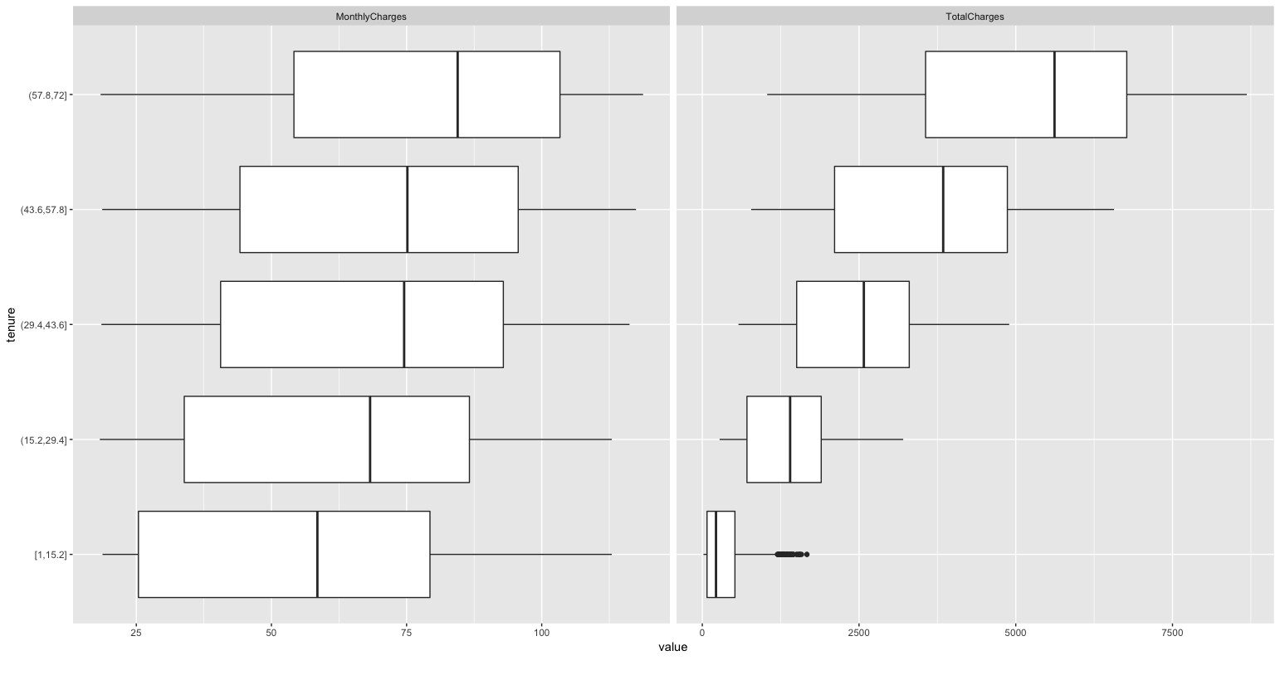
Exploration I
Both MonthlyCharges and TotalCharges values increase the longer a person has been with the company.

Slide 6
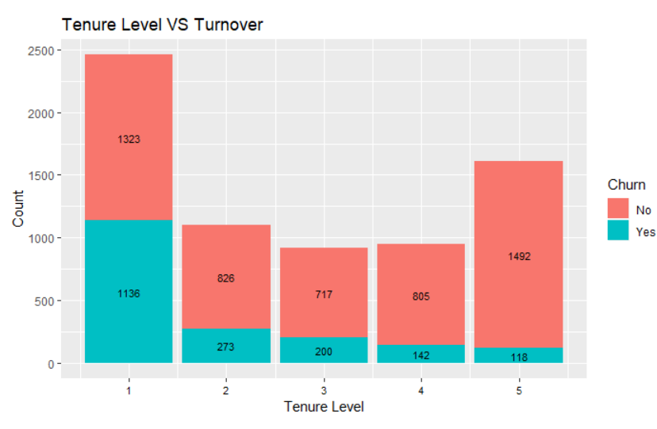
Exploration II
Groups of clients with longer time with the Telecom turn over less.
Each “level” is about 15 months.

Slide 7
Identifying the At Risk Group
With the majority of turnover occuring in the first 15 months. We believe the behavior we want to identify primarily exists within this group.
We created a subset of our data to focus on this window.

Slide 8
R Modeling
Given this identified group:
We found the three best regression models in R (using glmulti) based on AIC scores
We can narrow our scope to: SeniorCitizen, MultipleLines, InternetService, OnlineSecurity, OnlineBackup, TechSupport, Contract, PaperlessBilling, PaymentMethod, tenure, MonthlyCharges, TotalCharges

Slide 9
Odds Ratios I
Odds Ratio 2.5 % 97.5 %
(Intercept) 4.592691e-01 2.029058e-01 1.034991896
SeniorCitizen1 1.300938e+00 9.973395e-01 1.702429177
MultipleLinesNo phone service 2.897344e+00 1.902196e+00 4.428399995
MultipleLinesYes 1.359694e+00 1.062584e+00 1.741105491
InternetServiceFiber optic 1.495077e+00 9.643898e-01 2.319625996
InternetServiceNo 8.046496e-01 4.864395e-01 1.332738988
OnlineSecurityNo internet service NA NA NA
OnlineSecurityYes 5.507624e-01 4.127503e-01 0.732842994
OnlineBackupNo internet service NA NA NA
OnlineBackupYes 7.008759e-01 5.413774e-01 0.906865113
TechSupportNo internet service NA NA NA
TechSupportYes 6.955157e-01 5.141790e-01 0.939566728
ContractOne year 3.515974e-01 1.892778e-01 0.612422942
ContractTwo year 3.829072e-07 1.007455e-48 0.002460312
PaperlessBillingYes 1.479569e+00 1.208416e+00 1.811044759
PaymentMethodCredit card (automatic) 6.708471e-01 4.464282e-01 1.005967529
PaymentMethodElectronic check 9.300973e-01 6.751238e-01 1.279404429
PaymentMethodMailed check 7.405657e-01 5.287816e-01 1.038012747
tenure 8.476019e-01 7.963772e-01 0.900113990
MonthlyCharges 1.018981e+00 1.004192e+00 1.034145938
TotalCharges 1.000881e+00 1.000003e+00 1.001778412
From the model, we can look at computed odds for each variable.
We can pick out Contract as a key factor.

Slide 10
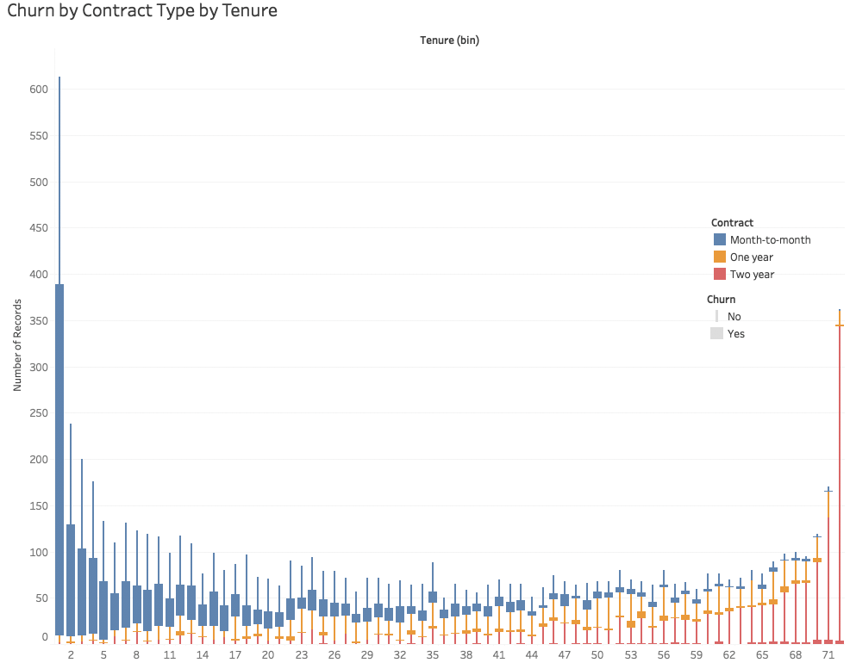
Exploration III
96% of customer turnover occurs on Month-to-month contracts.
60% of documented customer turnover occurs within the first 15 months.

Slide 11
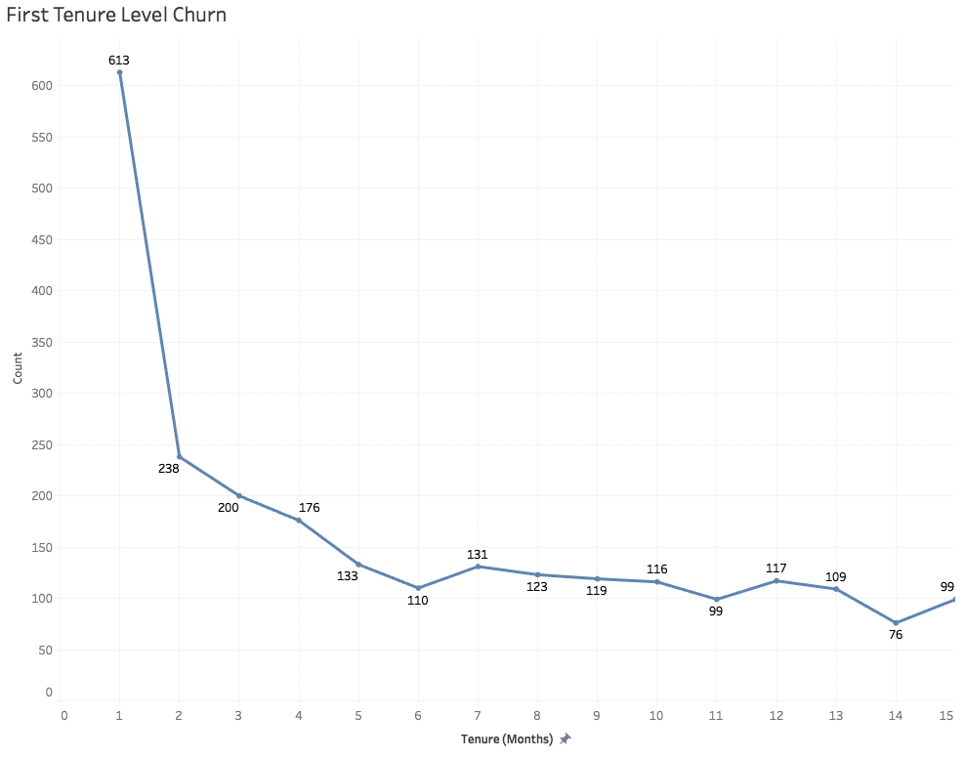
Digging Deeper
Most turnover happens on the first month.
Followed by a sharp decline, and slower decrease.

Slide 12
Data Processing II
Given the first month turnover:
We took another subset focusing on these customers.
Further refinement of variable scope: SeniorCitizen, PhoneService, OnlineSecurity, TechSupport, Contract, PaperlessBilling, TotalCharges

Slide 13
Odds Ratios II
Odds Ratio 2.5 % 97.5 % (Intercept) 4.074581e-01 0.18655343 8.985406e-01 SeniorCitizen1 2.153155e+00 1.11218613 4.460473e+00 PhoneServiceYes 2.084525e-01 0.08901276 4.763333e-01 OnlineSecurityNo internet service 2.016002e+00 0.90497516 4.531350e+00 OnlineSecurityYes 4.324523e-01 0.20266377 9.145335e-01 TechSupportNo internet service NA NA NA TechSupportYes 2.899332e-01 0.12916060 6.359916e-01 ContractOne year 2.539274e-07 NA 1.051647e+14 ContractTwo year 3.634430e-07 NA 5.092188e+63 PaperlessBillingYes 1.697654e+00 1.14807985 2.507677e+00 TotalCharges 1.051597e+00 1.03423474 1.070170e+00
After the first month the customers most likely to stay all have:
PhoneService
TechSupport
OnlineSecurity
Those that do not are more likely to leave.

Slide 14
Questions Answered
How can Telecom hold on to these customers?
Avoid Month-to-month contracts.
Incentivise One/Two Year options
If stuck with a Month-to-month option:
Push sign ups for phone service
Gently remind clients of tech support options
Get clients to use/sign up for online security

Slide 15
Reflections
Analysis
Working with mostly categorical data was a new experience for us.
Retrospectively we isolated the most volatile segment.
Additional work required for subtlety of longer contract types.
Dataset
Generating models took longer than expected.
Subsetting data can be very important

